Slide 1

Vehicles Moving Along Roads: A Linked List Approach
Linked lists are a fundamental data structure in computer science. Their versatility makes them suitable for various applications, including simulating vehicle movement along roads.

Slide 2

What is a Linked List?
1
Nodes
2
Data
A linked list is a linear data structure comprising individual nodes.
Each node stores a data value, such as vehicle information.
3
Pointers
Nodes are connected through pointers that point to the next node in the list.

Slide 3




Data Flow and Representation
Vehicle Data
Pointers
Road Simulation
Each node in the linked list represents a vehicle.
Pointers maintain the order of vehicles, creating a continuous flow.
The linked list simulates vehicles moving along a virtual road.

Slide 4

Linked List Operations in Vehicle Management
Operation
Description
Insertion
Adding a new vehicle to the list.
Deletion
Removing a vehicle from the list.
Traversal
Iterating through the list to update vehicle positions.

Slide 5
Advantages of Linked Lists in Vehicle Simulation
Dynamic Allocation
Efficient Insertion/Deletion
Flexibility
Linked lists can grow and shrink dynamically, accommodating changing traffic conditions.
Adding or removing vehicles from the list can be done efficiently without needing to shift elements.
Linked lists allow for flexible vehicle arrangements, such as lane changes and overtaking.

Slide 6
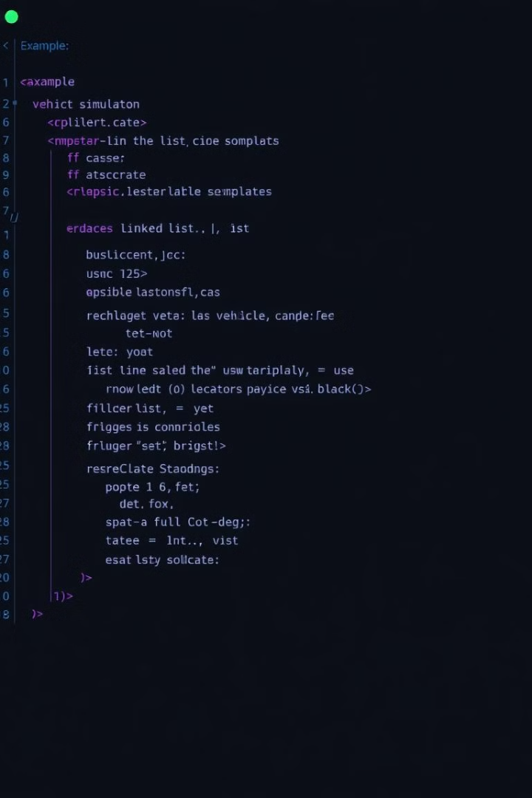
Live Coding Example
A live coding demonstration will showcase the implementation of a linked list for vehicle simulation in a chosen programming language.

Slide 7

Conclusion and Future Enhancements
1
Efficiency
Optimize the implementation for better performance and scalability.
2
Features
Add more complex features, such as traffic signals and pedestrian interactions.
3
Visualization
Enhance the visual representation of the simulation for a more engaging user experience.

